Slide 1
Privacy Preserving Authentication with Modern cryptographic techniques
MONASH INFORMATION
TECHNOLOGY
Trung Dinh
Supervisors:
Dr Ron Steinfeld
Dr Nandita Bhattacharjee

Slide 2
Outline
Project Summary
The protocols
Variant 1: Computing HD homomorphically
Variant 2: Covering Circuit Privacy
Variant 3: Computing & Comparing HD homomorphically
Variant 4: Removing the overhead
Conclusions

Slide 3
Project Summary
Context & Motivation
User Authentication & Biometrics
Biometrics data should be handled with care
Requirements
Privacy against the server
Quantum Resistant
Third Party non-reliance
Malicious Client Model
Multifactor security
Practical performance
Related works
3 main approaches
The HE approach
Notes:
Feature transform (cancelable biometrics or biohashing): Server still has to keep a key
Fuzzy vault & Fuzzy Matching: error correcting code, security is heuristic
HE

Slide 4
Contributions
Disciplinary contribution: a first protocol that provide all of the features
Technical contributions:
A formal model for privacy-preserving biometric authentication
2 new variant ZKPs of plaintext for lattice-based cryptosystems
Decomposition and Combination techniques to balance computation and communication in applications using lattice-based crypto techniques
A new technique to improve security analysis of noise-based cryptosystems to provide both efficiency and provable-security.

Slide 5
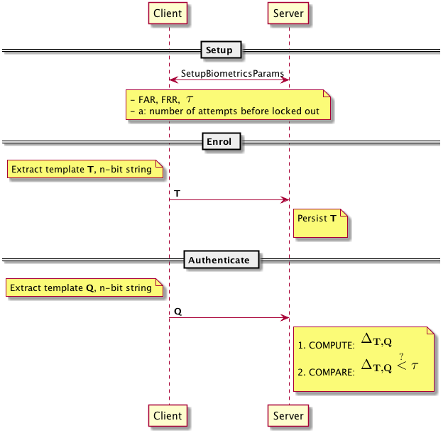
The protocols – The basic form – nonprivate
Main parties: Client & Server
Main Steps: Enrolment & Authentication
Distance between T and Q
The goal: Protect T and Q
Our scope:
3 approaches to privacy-preserving
Hamming Distance
Iris bit string (1024-2048 bits)

Slide 6
The threat model
Active Multi-factor Client
Can have access to one of the factor
Not Honest But Curious
Passive Server
Can observe the protocol transcript
Can access HD value (first and second variant)

Slide 7
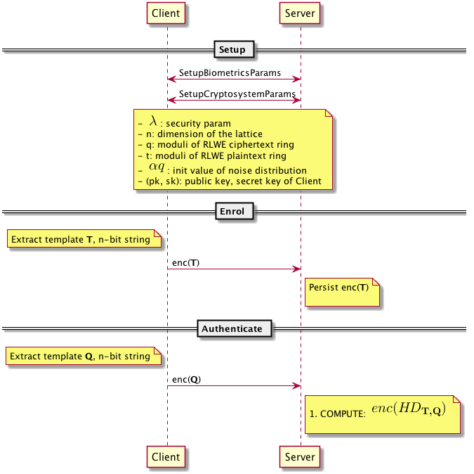
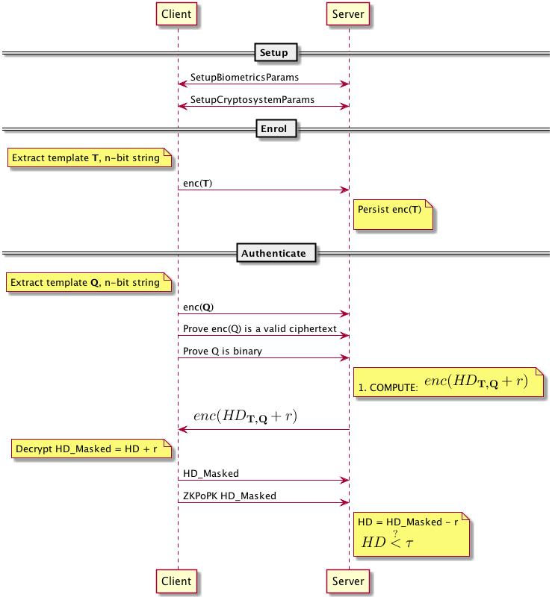
The protocol – First Variant
The natural approach
Yasuda et. al. [2014] technique
The trusted third party
Our approach
Who should decrypt
Problems:
HD expose to client?
Client is malicious
Solutions:
1 homomorphic addition
ZKP to enforce active security
The ZKPs’ cost
Results:
Security level: 142-152
Computation time: < 0.5 s
Communication size: ~ 8MB

Slide 8
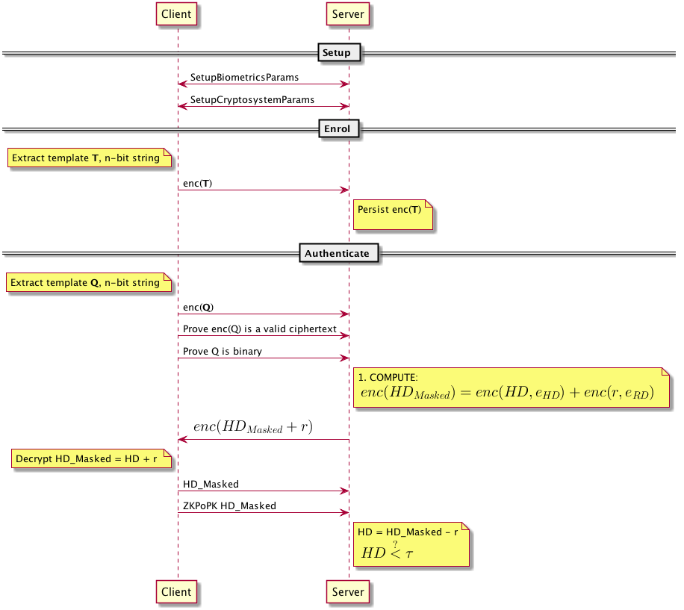
The protocol – The second variant
The problem: Circuit Privacy
We use RLWE cryptosystem, a noise-based one:
The ciphertext enc(HD+r) sent to the client has a noise element
The noise has correlated data to the original T
Our solution
Masking the noise with extra noise!
Not too much, not too few
A new application of Renyi Divergence analysis:
Other approach: Statistical Distance: Less efficient
Results:
Security level: 142-152
Computation time: < 0.5 s
Communication size: ~ 16MB

Slide 9
The protocol – Third Variant
Last protocols: we assume HD exposure is plausible
Question: Can we do one step further, hiding HD from the server?
Our approach
The goal: compute Enc(HD < t) homomorphically
Observation: HD < t iff MSB(2^{l} + t – HD) = 1
So we want to solve: enc (MSB(2^{l} + t – HD))

Slide 10
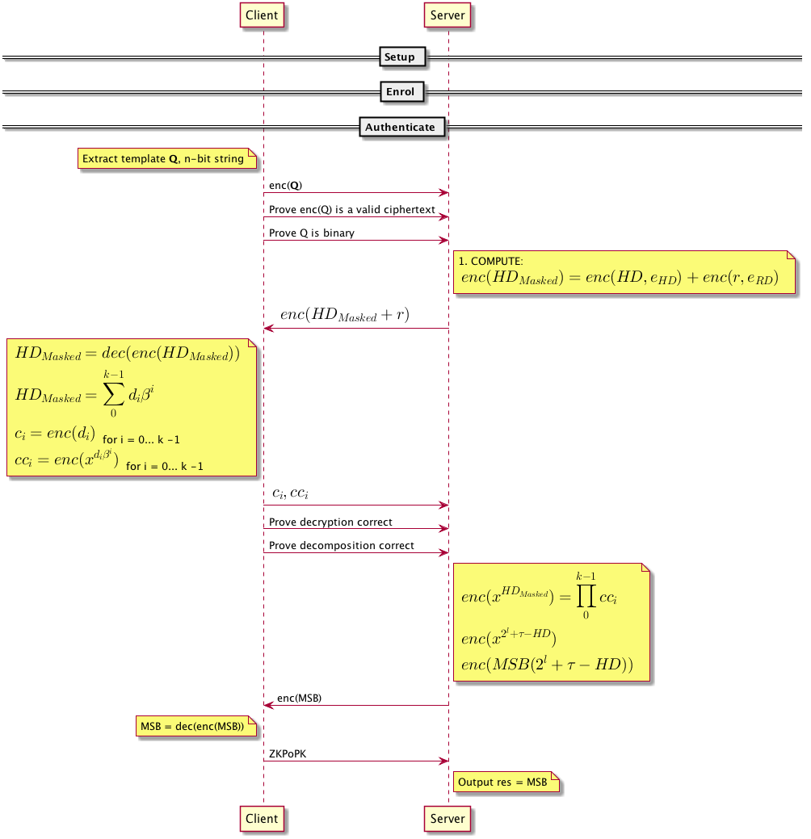
Results:
Security level: 92
Computation time: < 4 s
Communication size: ~ 40MB

Slide 11
The protocol – The fourth variant
The goal
Big changes
Replace Stern-based ZKP with
A Schnoor-based ZKP to prove small noise in ciphertext
A challenge response protocol to prove binary plaintext
Yasuda et. al. ‘s packing method is not applicable anymore
HD Computation based on CRT packed ciphertext
HD comparision using garbled circuit + oblivious transfer

Slide 12
Result – 4th variant
Results:?
Evaluation:
Homomorphic addition: n log(n)
Homomorphic multiplication: 0, but log(n) keyswitches
Circuit size (Comparator circuit): 2*log(n) NAND gates + log(n) OR gates
Expectation:
Same cost as the first variant
Only expensive when initializing the protocol!

Slide 13
Summary
 | Multi-factor | Distance Non-Exposure | Low Init overhead | Low Communication
Protocol 1 | 0 | 0 | 1 | 1
Protocol 2 | 1 | 0 | 1 | 1
Protocol 3 | 1 | 1 | 1 | 0
Protocol 4 | 1 | 1 | 0 | 1

Slide 14
Conclusion
Research questions
How practical it is to provide long term security (quantum-resistant) for highly private data?
With cloud computing being deployed widely, would it be possible not to rely on trusted third parties to do biometric authentication to reduce the overall risk of template exposure?
Is it practically possible to protect against malicious client model for two-party protocols that used lattice-based cryptographic techniques?
Publications:
First & Second Variant: ISPEC 2017
Third Variant: IEEE S&P Journal (November)
Fourth Variant:

Slide 15
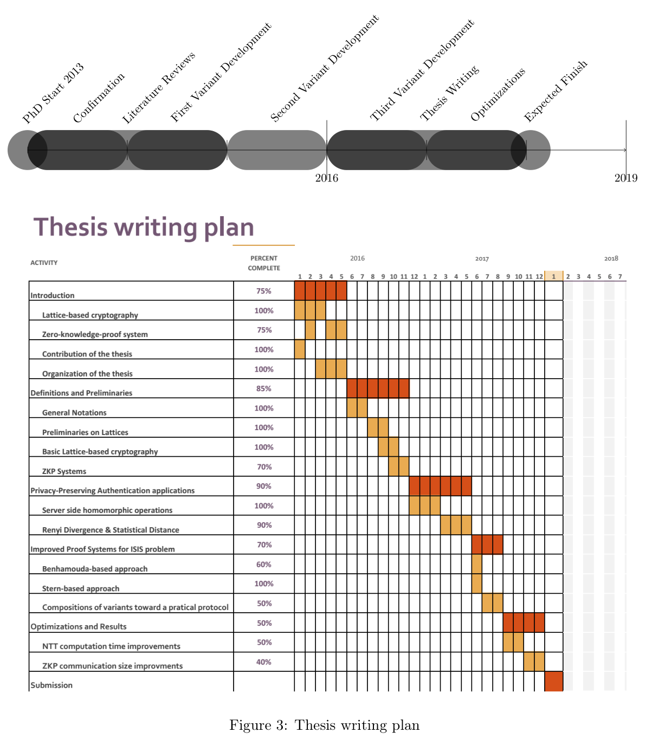
Timeline

Slide 16
Q & A
THANK YOU!

